Slide 1
Writing your bachelor’s thesis at the BA in Marketing and Management Communication
November 2018
Department of Management
Anne Ellerup Nielsen, Professor, PhD.
Programme Coordinator BA MMC

Slide 2
Agenda
Rules and regulations for the BA thesis
What is a BA thesis in Marketing and Management Communication?
BA thesis: subject, problem statement, and process
Links and good advice
Questions?

Slide 3
Rules and regulations for the BA thesis
Project report:
Genre: academic paper
Project report is written individually or in groups (max 4)
Length: (excl. front page, table of contents, summary, references and appendices)
1 student: max 25 pages
2 students: max 45 pages
3 students: max 60 pages
4 students: max 70 pages
+ summary (max. 2 standard pages)
1 standard page = 2,200 characters excl. spaces
https://eddiprod.au.dk/EDDI/webservices/DokOrdningService.cfc?method=visGodkendtOrdning&dokOrdningId=11787&sprog=en
NB! Max number of pages is not to be exceeded
(i.e. there is no such thing as give or take a couple
of pages)
Don’t forget to state the length of the paper
(i.e. the actual number of characters)

Slide 4
Rules and regulations
Supervision
The program coordinator allocates the BA theses to supervisors according to areas of teaching and planning purposes.
Students who have chosen the same or related subjects will be placed in groups with one supervisor for each group. If a subject cannot be approved, you will be contacted.
Max. 9.5 hours for supervision per project (incl. the meetings, but also e-mail correspondence, telephone meetings, reading of excerpts handed in in advance, etc.)

Slide 5
How does it work?
Considerations on subjects, challenges, problems
Choice of subject (Form: see Study Portal: http://studerende.au.dk/en/studies/subject-portals/corporate-communi
cation/bachelors-and-masters-thesis/bachelors-project-bammc/
Based on your choice of subject and on suggestions, if any, for supervisors, you will be assigned a supervisor.
The supervisor initiates the first supervising session
Ongoing supervision and sparring. Stops when you have handed in your BA thesis

Slide 6
Questions from the floor!
Is there a list of supervisors?
No. The supervisors for the BA projects change from year to year – more than they do for MA theses. But if you have had a good teacher during your study program, you are welcome to suggest him or her as your supervisor.
Can we choose a supervisor who is not teaching in this study program?
Basically not.
What if I’d rather have had another supervisor?
Basically, it is not possible to change your supervisor during the thesis period. The supervisor is assigned to you according to the subject you have chosen – and the assigning of supervisors is thus based on the area of teaching.

Slide 7
What is a BA thesis?
A BA thesis (BA project, project report)
is an academic paper/text:
Independent search and acquisition + systematic
and methodical processing of professional knowledge through
own studies of academic literature and possibly field studies
Independent and critical analysis of issues within the subject area
Written formulation in a well-structured, clear and easily comprehensible manner
(cf. Course and exam description (BA thesis):competencies developed)

Slide 8
What is a BA thesis?
Empirical BA thesis:
Questions to phenomena you have observed,
experienced or collected (using theories …)
Theoretical BA thesis:
Questions to theory (Careful! Don’t let it become an entirely theory-referring text!)
Action-prescribing BA thesis/ BA thesis with a product:
Aims at proposing suggestions or recommendations (Careful! Don’t let it become unscientific)

Slide 9
Types of action prescribing thesis
Exploratory Research Descriptive Research Causal Research
(Unaware of Problem) (Aware of Problem) (Problem Clearly Defined)
“Our sales are declining and “What kind of people are buying “Will buyers purchase more of
we don’t know why.” our product? Who buys our our products in a new package?
competitor’s product?”
“Would people be interested “Which of two advertising
in our new product idea?” “What features do buyers prefer campaigns is more effective?”
in our product?”

Slide 10
What is a BA thesis?
Study design
Bottom up (field work – interpreting): empirical problem setup
Top down (theory test – explaining): theoretical problem setup
“spiraling” (Berg 2007) (cyclic vs. linear – understanding)
Study techniques (method)
Acquiring theoretical ideas
Interview
Observation of behaviour, forms of meeting and conversation, using equipment, etc.
Observation of layout, arrangement of workplace, etc.
Written artefacts, memos, minutes, annual reports, advertising material, instructions, manuals, etc.

Slide 11
BA project in Marketing and Management Communication
Written in English
Subject within the area of communication in the widest sense (has to be approved by supervisor)
Both theoretical and empirical problem setups are possible
Empirical data have to be in English (all the parts used in the project translated into English)
Theories (primarily) within the subject area
Methods (e.g. analytic tools)
Genre: report
NB! Don’t re-contact companies or organisations who respond that they don’t want to or have time to provide information for your study!

Slide 12
Evaluation criteria (cf. course and exam description)
In the assessment of the extent to which the student meets the objectives of the bachelor project, emphasis is placed on the student’s ability to:
focus on aspects that are important to the subject area
choose theories, methodology and source material appropriate for the topic
demonstrate critical sense in selecting and applying the source material
demonstrate independence and critical sense in analysis and argumentation
critically assess the extent to which the thesis (project results) are applicable in a concrete real-world context
write a well-structured thesis observing the formal requirements (structure, layout, etc.) to academic reports
compose the thesis in a precise, varied, clear and correct language

Slide 13
How do you write a BA thesis?
BA thesis as a “small MA thesis”: the classic disposition
Introduction
Appetizer
Problem statement
Method/delimitation
Disposition – intro to sections/coherence
Main part
Theory
Method
Empirical data
(Discussion +) Conclusion (+ perspectivating)
Literature/references
Appendices
Summary
Order and prioritizing depends on the study design:
(cf. “spiraling”, bottom-up or top-down)

Slide 14
How do you write a BA thesis?
Choice of subject
Extension of or starting point at previous assignment
Inspiration from specific subjects or lectures
Keeping informed through trade magazines and papers
Current issues in the press
Observation or experience of phenomenon
Etc. …
➲ Remember:
The subject has to sustain your interest for most of a semester: wondering, enthusiasm, interest

Slide 15
Questions from the floor!
“Can I write about e.g. crisis communication or corporate branding?”
Well, we can’t prevent you from writing about particular problems and subjects which you haven’t worked with during your studies. But we strongly suggest that you think twice …
… for several reasons:
You can risk using unreasonably much time on finding literature and reading it, so you might fall behind your time schedule and you won’t have time to do the actual writing.
There is a clear expectation that you are familiar with the subject area you are working with – if there are important theories you don’t know or there are questions about the area you can’t answer in the exam, it is not at valid excuse that you didn’t have it in class
The course and exam descriptions refer specifically to subjects that are relevant for the BA program.

Slide 16
How do you write a BA thesis?
Subject areas/subjects/problems for the registration form:
Marketing & Integrated Marketing Communication
Organizational Communication/Management Communication
Global Communication
Others subjects – e.g. inspired by electives, executive lectures, etc.
Focus on methods: e.g. textual and visual semiotics, discourse analysis

Slide 17
How do you write a BA thesis?
From subject to problem statement: five crucial questions
Questions of the study (problem statement): What are you asking?
Professional aim, or use, of the study: Why are you asking?
Empirical data, material, phenomenon: To what are you asking?
Tools of the study: theories, notions, subject specific methods: With what are you asking?
Method of the study: How are you asking?

Slide 18
How do you write a BA thesis?
The pentagon
(Rieneker et al. 2005)
Prioritize the job of filling in the pentagon
Problem statement
What do you ask?
Background and
motivation
How do you ask?
Why do you ask?
Method
With what do you ask?
To what do you ask?
Empirical data
Theory

Slide 19
How do you write a BA thesis?
A precise problem statement
A clear structure
Well-argued and well-documented
Easily comprehensible
Well written
(cf. Frandsen et al. 2002: chap. 11)

Slide 20
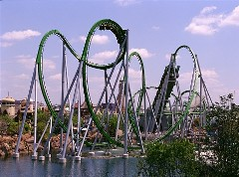
How do you write a BA thesis?
The process
Choice of subject
Focus on the problem statement and overall research question
Supervision/supervisor (clarification of expectations). NB: professional/subject-oriented supervision vs. process-oriented supervision.
Ambition
5. Time schedule and practical structuring of your work
6. Writing process: ”I’m the king of the world” vs. ”Heeeeeelp-days”

Slide 21
Questions from the floor!
“Do I HAVE to make a product?”
No. The BA thesis can also be theoretical in its scope, cf. the different types of theses.
”What if I get a better idea during the process?”
It depends … If there are big changes you should be aware of several things. Is it because you have difficulties making a final decision? Or is it because your original idea was too weak? Be careful not to change subject or focus between internal and external communication – the leap is too long as it can be problematic with respect to the assigned supervisor. You should rather keep the idea in store for a later opportunity– maybe you can recall it for a later assignment or perhaps for the MA thesis. But minor changes, differentiations and perspectives during the process are almost inevitable.
Remember always to confer with your supervisor!

Slide 22
Examples (theses@asb)
Legalized Sin
Successful Viral Communication
A Shift in Social Marketing and its Foundation
A Multimodal Discourse Analysis of Airbnb’s Political CSR Communication in Relation to Constructing the Brand’s Identity
A case study of Liverpool FC's brand community on Instagram
Strengthening brand equity through guerrilla marketing: a multimodal analysis of persuasive functions in Hell Pizza restaurant billboards

Slide 23
BA MMC thesis 2017
http://pure.au.dk/portal-asb-student/en/studentprojects/search.html?search=&uri=&advanced=true&type=+&language=+&education=42224&studentProjectYearsFrom=&studentProjectYearsTo=

Slide 24
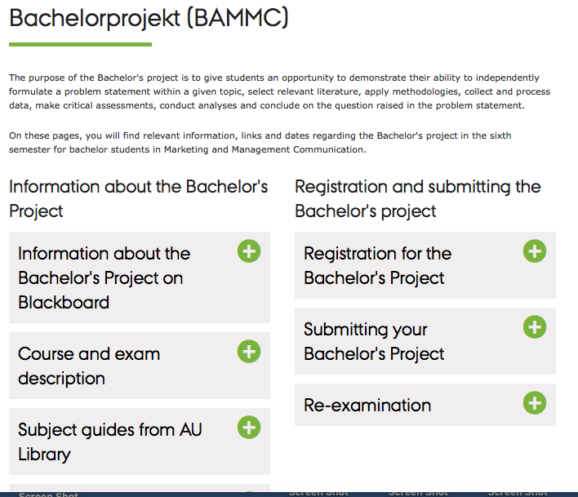
If you want to know more…
Study Portal: Bachelor’s thesis - Summer 2019

Slide 25
Links
Information on Bachelor’s theses from Bachelor study council (Study Portal)
http://studerende.au.dk/en/studies/subject-portals/corporate-communication/bachelors-and-masters-thesis/bachelors-project-bammc/
Course description
http://kursuskatalog.au.dk/da/course/79983
What can the Library offer?
http://library.au.dk/en/resources/databases/
Previously handed in BA theses:
http://pure.au.dk/portal-asb-student/da/studentprojects/search.html?showAdvanced=true&advanced=true
Job and project bank of AU Career
coordinating project cooperation between
companies and students:
http://bss.au.dk/en/cooperation/recruit-among-students-and-graduates/cooperation-with-students/project-collaboration/

Slide 26
Good advice
Know the rules and regulations and the course and exam descriptions
Be aware of deadlines
Find a subject that interests you
Use some time on the problem statement
Coordinate your mutual expectations with your supervisor
Keep your appointments, prepare for the meetings, and don’t be afraid to set the agenda for the meeting (minutes from the meetings?)
Be sure to produce and forward drafts regularly or according to what you and your supervisor agree upon
Remember it’s OK to have off-days. Use them to recharge your batteries, then you’re ready to work hard the day after.
Enjoy!

Slide 27
Important dates
1st December Deadline for submitting the registration form for choice of subject lenely@mgmt.au.dk
15th January List of subjects and supervisors is uploaded on Blackboard
From 1. February Supervising process (individual/group)
First supervision meeting during weeks 6-7
Approx. 1. March Final project outline approved by supervisor
1. May Deadline for submission of BA thesis. Upload at THESES@bss.dk and to WiseFlow.
NB! For further questions contact Lene Lybech (lenely@mgmt.au.dk)

Slide 28
Good luck with your BA thesis
Anne Ellerup Nielsen
aen@mgmt.au.dk

Slide 29
Literature
Berg, Bruce L. (2007): Qualitative Research Methods for the Social Sciences. 6th ed. Boston: Allyn & Bacon.
Burr, Vivien (1995): An Introduction to Social Constructionism. New York: Routledge.
Chalmers, A.F. (1999): What is This Thing called Science? 3rd ed. Buckingham: Open University Press.
Daymon, Christine (2011): Qualitative research methods in public relations and marketing communications. 2nd ed. New York/London: Routledge.
Frandsen, Finn (2002): Netværk: Introduktion til international erhvervskommunikation. Aarhus: Systime.
Palmer, Richard E. (1985): Hermeneutics. Interpretation theory in Schleiermacher, Dilthey, Heidegger, and Gadamer. Evanston: Northwestern University Press.
Rienecker, Lotte & Stray Jørgensen, Peter (2006): Den gode opgave. Frederiksberg: Samfundslitteratur.

