Slide 1
Master thesis information meeting Sofie veje and Jacob bonde Student Counsellors for Business communication and business language

Slide 2
Programme
17.00 – 17.15 ”Rules and deadlines” by Sofie Veje & Jacob Bonde - student counsellors
17.15 – 17.25 ”Corporate contracts by AU Career” by Jane Midtgård Madsen
17.25 – 18.10 ”Writing a thesis” by Marianne Grove Ditlevsen
18.10 – 18.25 ”Information and research when writing your thesis” by Betina Sjøstrøm

Slide 3
The process of the thesis
All students (the only lack of activity = thesis) will be automatically registered for their master thesis the 1st of February (Unless a student is delayed or have any other special circumstances)
Possible to start the thesis 2 times a year (spring semester or winter semester)
Not possible to cancel the registration
Pre-registration = beginning of the thesis process
4 months to write your thesis

Slide 4
The process of the thesis
After submitting your thesis → 1 month for evaluation and oral defence
Three attempts at passing the thesis: Modified thesis synopsis and a new deadline of three months begins immediately after the failed deadline (whether you fail or choose to postpone submission date)

Slide 5
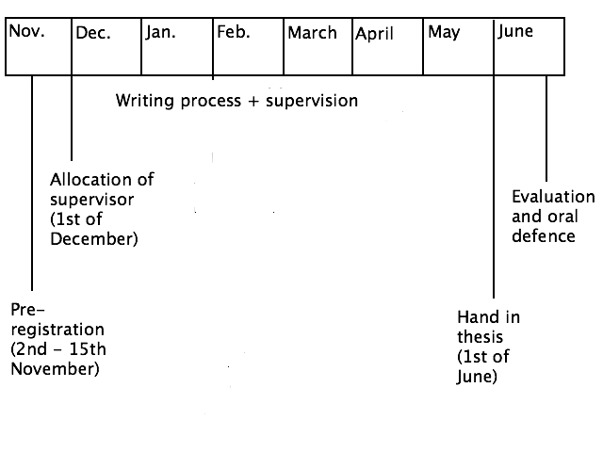
The process – 1st of February

Slide 6
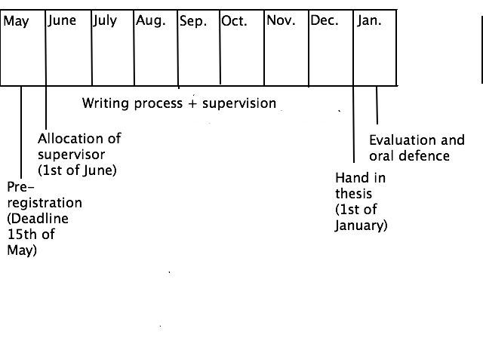
THE PROCESS – 1ST OF SEPTEMBER

Slide 7
Allocation of academic supervisor /Pre-registration
Online pre-registration from the 2nd of November – 15th of November OR 1st of May – 15th of May (You will receive further information)
The content of the pre-registration:
Subject area
Methods of data collection and analysis
A small project description
Can I request a specific supervisor?
Students within language: Yes Students within communication: No

Slide 8
Allocation of academic supervisor /Pre-registration
At latest the 1st of December/1st of June, your programme coordinator will allocate you a supervisor
After the pre-registration (From 1st of December – 1st of June/1st of May – 1st of January) you will have the opportunity to meet with your supervisor and start the writing process

Slide 9
scope of the thesis:
The thesis may be prepared individually or in groups of max. 3 students
Scope:
- 1 student: 50-80 standard pages (2.200 characters, excluding blanks)
- 2 students: 75-120 standard pages
- 3 students: 100-150 standard pages
Excl. table of contents, literature list, abstract and appendices, but incl. notes.
Length of the abstract: Max. 2 standard pages.
Individual oral exam: 45 min.

Slide 10
THESIS – HOW TO SUBMIT ONLINE:
When the thesis is written → upload at the library portal (Find link at the Study Portal)
Print the receipt for your upload/registration (= proof that you have uploaded/registered)
Any questions: contact the Library
Hand in at BSS Study Service, Tåsingegade 3, building 1443, room 021
A copy of the mail receipt from the library
2 printed copies of your thesis
3 completed copies of the form 'Submission of master's thesis‘ (Find it at the Study Portal)

Slide 11
Spaces reserved for thesis writers
Both at the Nobel Library (BCOM), Bartholins Allé (1351 in the University park) and at AU Library Fuglsangs Allé: Find more information at the Study Portal:
http://studerende.au.dk/fileadmin/studerende.au.dk/BSS/bcom/Vejledning/Bachelorprojekt_og_kandidatafhandling/Kandidatafhandling/Specialepladser_-_2015.pdf
Possible to book classrooms, library spots and group rooms at both the Nobel Park, Fuglsangs Allé, Trøjborg, etc.: http://studerende.au.dk/en/studies/subject-portals/jur/studiemiljoe/webroombooking/

Slide 12
Questions?

