Slide 1
Information meeting about electives

Slide 2
Agenda for today
16.15-16.30
Rules and deadlines by the student counsellors
Presentation by director of studies Mogens Dilling-Hansen
Elective package in Psychology by Eliane Choquette
16.30-17.15
Three rounds of presentations by course coordinators in
separate zoom-rooms
(16.30-16.45, 16.45-17.00 & 17.00-17.15)

Slide 3
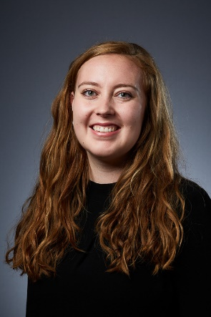
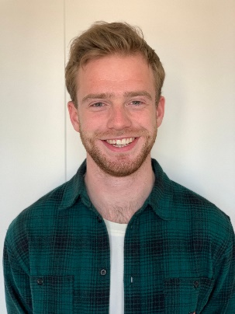
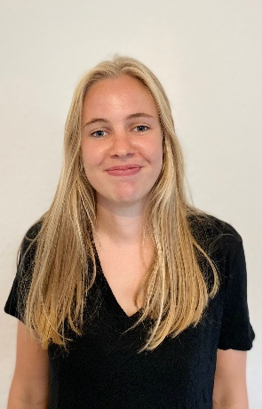
Who are we?
CONTACT: counsellor.badm@au.dk
Anne Kirstine Thomsen
Student counsellor for Economics and Business Administration
4th semester in Commercial and Retail Management
Anders Jepsen
Student counsellor for Economics and Business Administration
4th semester in HA
Nikoline Boye Dyhrberg
Student counsellor for Economics and Business Administration
6th semester in HA

Slide 4
Autumn electives 2022

Slide 5
Autumn electives at au
To find electives you can use:
The study portal
The course catalogue (use the correct filters)

Slide 6
Overview of Elective Courses

Slide 7
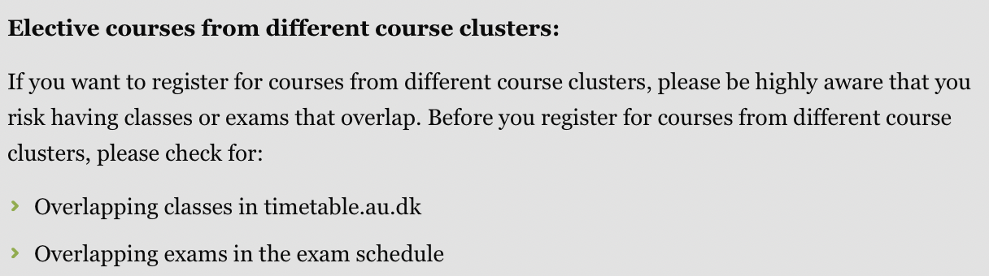
Course Clusters
It is your own responsibility to make sure you fulfill the academic prerequisite
It is your own responsibility to make sure the course does not overlap with another course in your study program → pick from clusters/look at Timetables
It is your own responsibility to make sure that if you choose courses outside clusters, that the exams doesn’t overlap

Slide 9
Timetable
In the autumn 2022, the digital display of your timetable will be shown in the system 'Timetable.au.dk’.
The autumn 2022 timetable will be announced on Thursday, 28 April.
Link: https://studerende.au.dk/en/studies/subject-portals/business-administration/teaching/timetables/

Slide 10
How to find Timetables

Slide 11
Registration
Register between the 1-5 of May 2022 in STADS
Find the step-by-step process for the registration process for Autumn electives on the Study Portal
Link: https://studerende.au.dk/en/studies/subject-portals/business-administration/teaching/electives/bsc-in-economics-and-business-adm/

Slide 12
Cancelling of elective courses
You cannot deregister or change your electives after the deadline 5th of May 2022

Slide 13
Courses outside AU

Slide 14
Electives at another Danish University
You will be on your own as a guest student
Follow the application procedure and guidelines at you guest university
Apply for a pre-approval at mystudies.au.dk
NB: This can take up to 8 weeks
Remember to transfer your credits after you have completed your courses outside of AU
Notes:
It is your own responsbility to familiarise yourselves with the deadlines and procedures at the respective universities

Slide 15
SUM up deadlines

Slide 16
Important dates
15 April - Course catalogue opens
28 April - Timetable autumn 2022
28 April - Exam plans available winter 2022/2023
1-5 May - Course registration

Slide 17
Questions

Slide 18
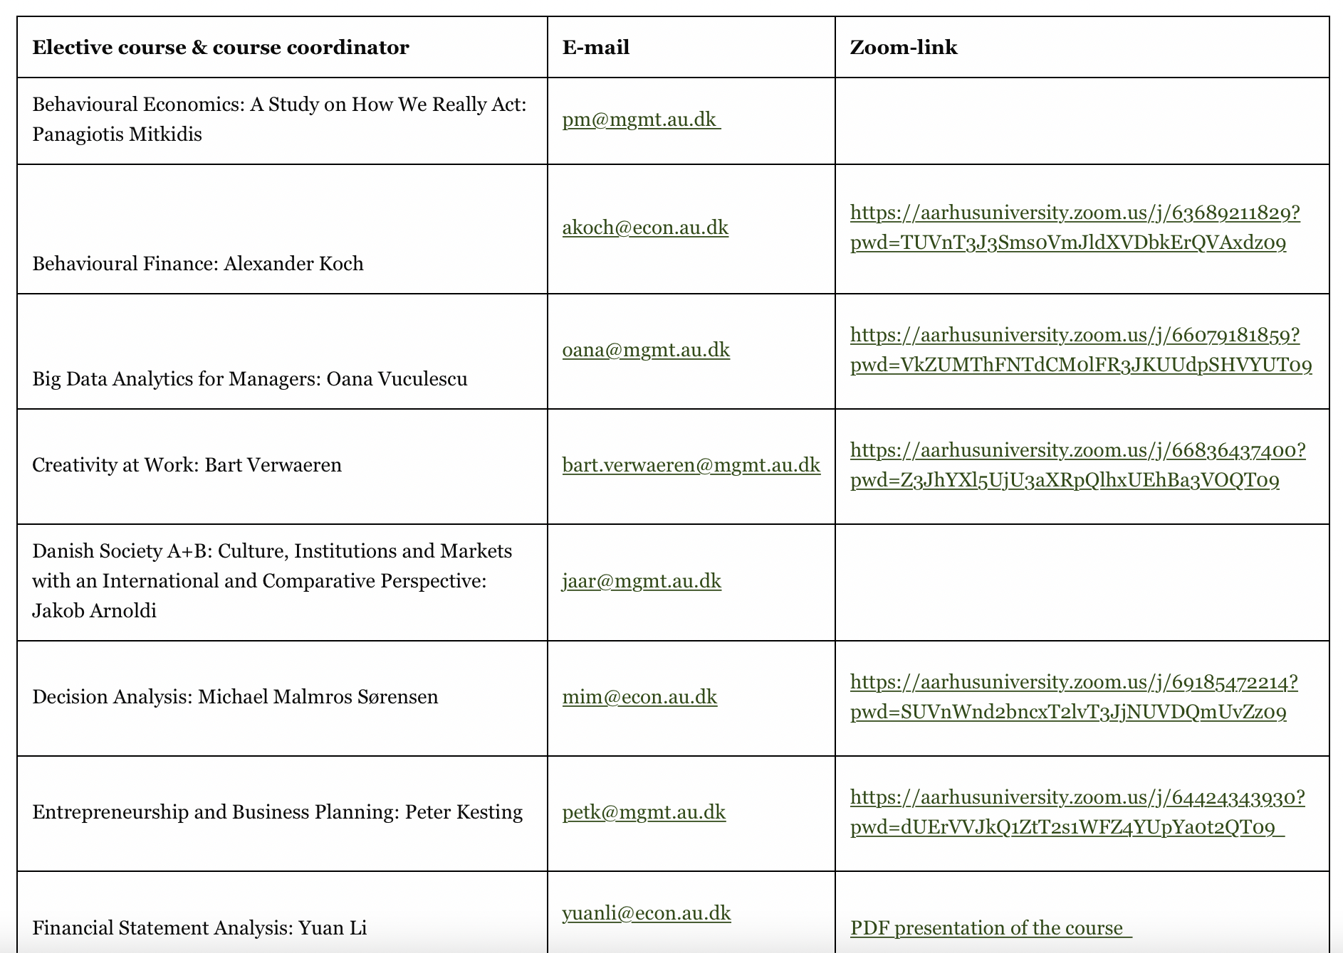
Three Presentations rounds
Now there will be three rounds of presentations by the course coordinators
1. Round: 16.30-16.45
2. Round 16.45-17.00
3. Round 17.00-17.15

Slide 19
How to acCess zoom-links
To find the overview of the links go to the Study Portal (student.au.dk) →
Teaching → Electives → Bsc in Economics and Businesss Adm.
OR
Find the link on our facebook page ”Student Counselling for Economics & Business Adminstration”

